Slide 1


Predicting World GDP Based On Countries Social, Economic and Cultural Data
CPSC-6300 Applied Data Science- Project
Demonstrating the concepts learned in the class
Presented By:
Eshaa Deepak Sood, CU ID-C16170243
Vikas Garg, CU ID-C13373961
Group No. - 7

Slide 2
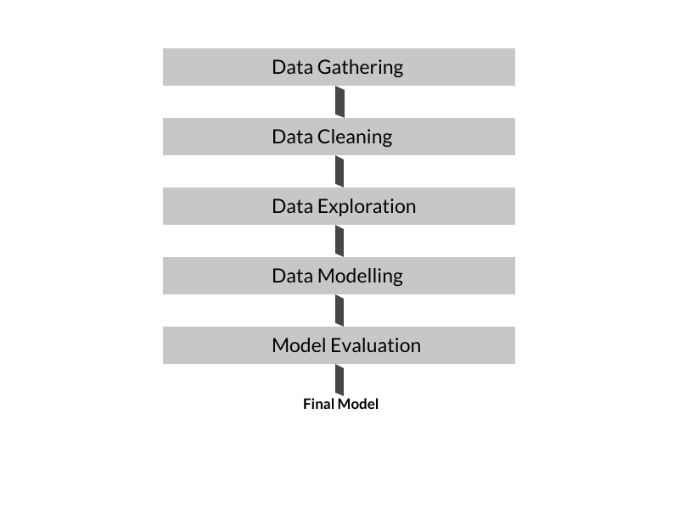
Introduction
Demonstrate the concepts learnt in the course
Data Gathering
Data Cleaning
Data Visualization & Exploration
Data Modelling
Evaluation & Validation of Models
Supervised learning methods used.
Compare performance of different supervised methods.
Programming platform used-Python & libraries, Jupyter, Github.

Slide 3
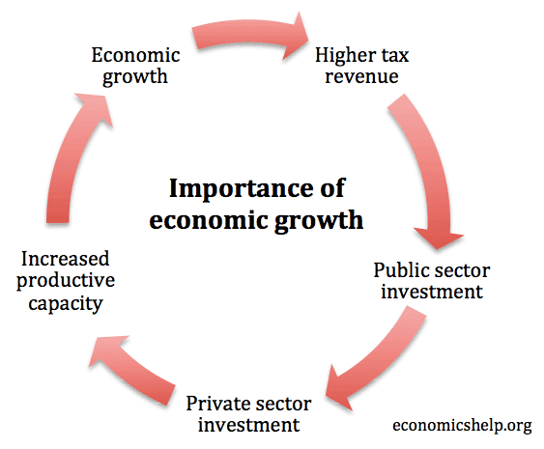
Problem Description and Motivation
Gross Domestic Product (GDP) is the value of services produced by a country.
GDP depends on many parameters:
Geographical- Land, Weather
Demographic- Population, skilled vs non-skilled labour, Literacy rates, employment
Cultural & social- Family values, spending power

Slide 4
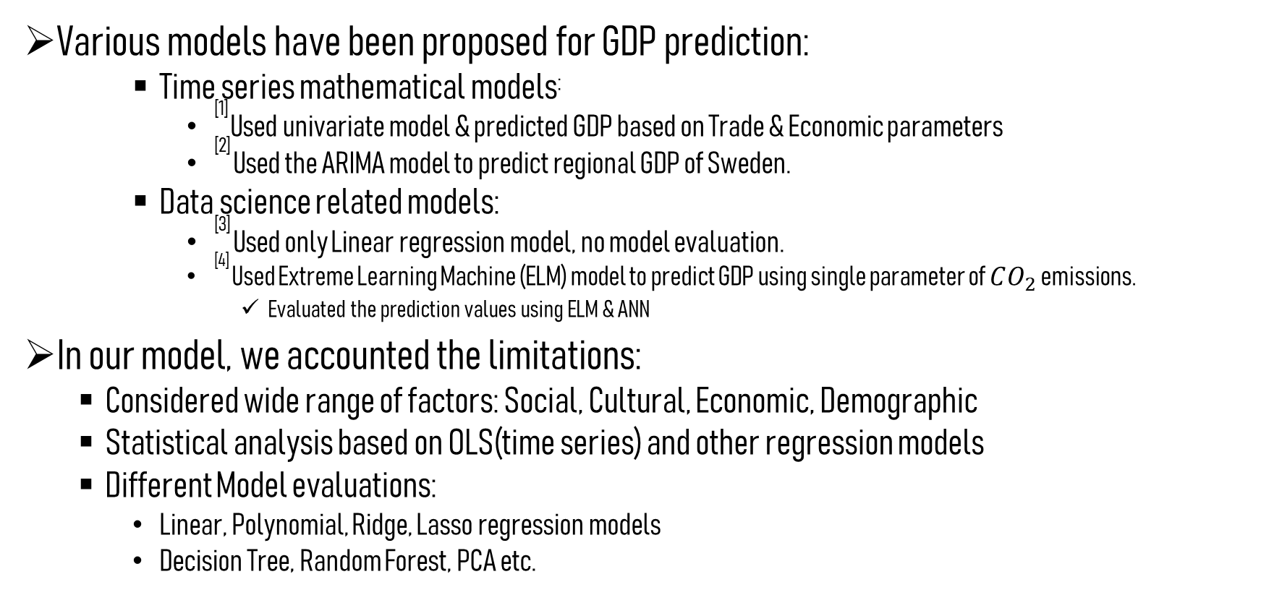
Literature Review & Motivation
Various models have been proposed for GDP prediction:
Time series mathematical models:
^{[1]} Used univariate model & predicted GDP based on Trade & Economic parameters
^{[2]} Used the ARIMA model to predict regional GDP of Sweden.
Data science related models:
^{[3]} Used only Linear regression model, no model evaluation.
^{[4]} Used Extreme Learning Machine (ELM) model to predict GDP using single parameter of $CO_{2}$ emissions.
Evaluated the prediction values using ELM & ANN
In our model, we accounted the limitations:
Considered wide range of factors: Social, Cultural, Economic, Demographic
Statistical analysis based on OLS(time series) and other regression models
Different Model evaluations:
Linear, Polynomial, Ridge, Lasso regression models
Decision Tree, Random Forest, PCA etc.

Slide 5
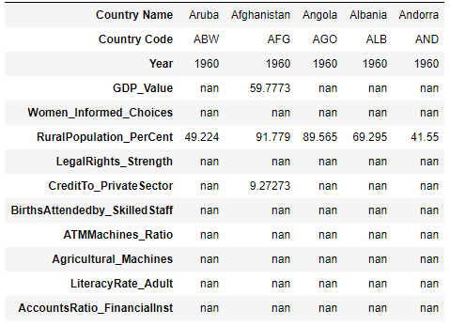
Data Gathering
Data is collected from authenticated sources:
World Bank Data^{[5]}, Kaggle datasets^{[6]}
58 year’s data is collected, 1960-2017.
Key features Country_Name, Year.
Target value: GDP_value.
We have all numerical features.

Slide 6
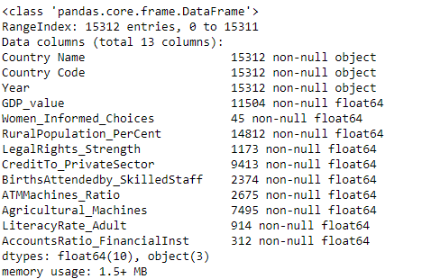
Data Categorization
Our models consists of both numerical and non-numerical features.
We are not using “object” type of features- represents country names and codes,
We have 10 numerical features and 1 numerical target value.
All of the 11 features contain null or NaN values.

Slide 7
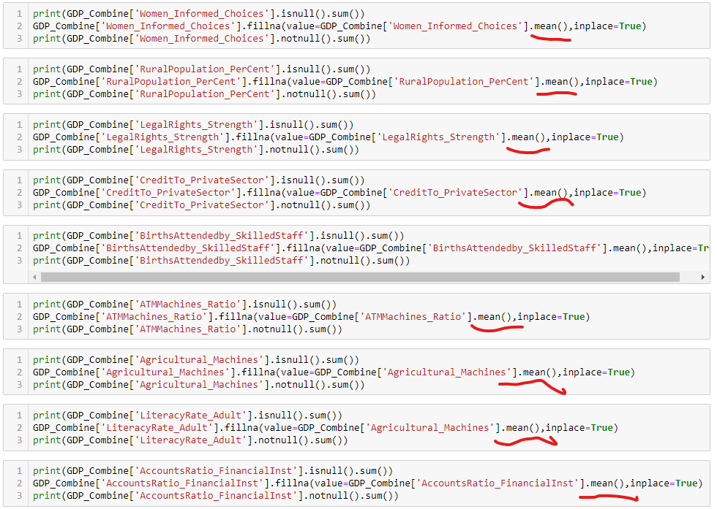
Data Cleaning
Some of the common features were merged together using “inner join”.
We replaced the “NaN” or missing values, by the mean of respective columns:

Slide 8
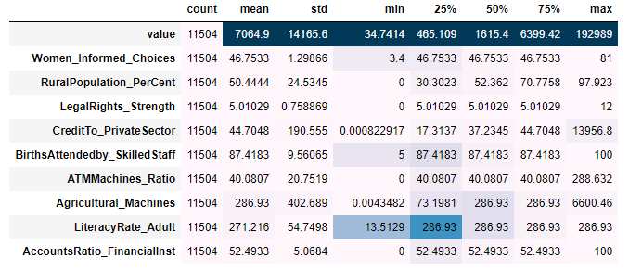
Data Visualization & Exploration
Statistical analysis of the features:
Coefficient of variation (CV) for value (GDP_Value) is approx. 200%.
Minimum GDP is 34.74 and Maximum is 192989. Extreme outliers are there in the target value.
Range of GDP value is approx. 192,000.
Contd.

Slide 9
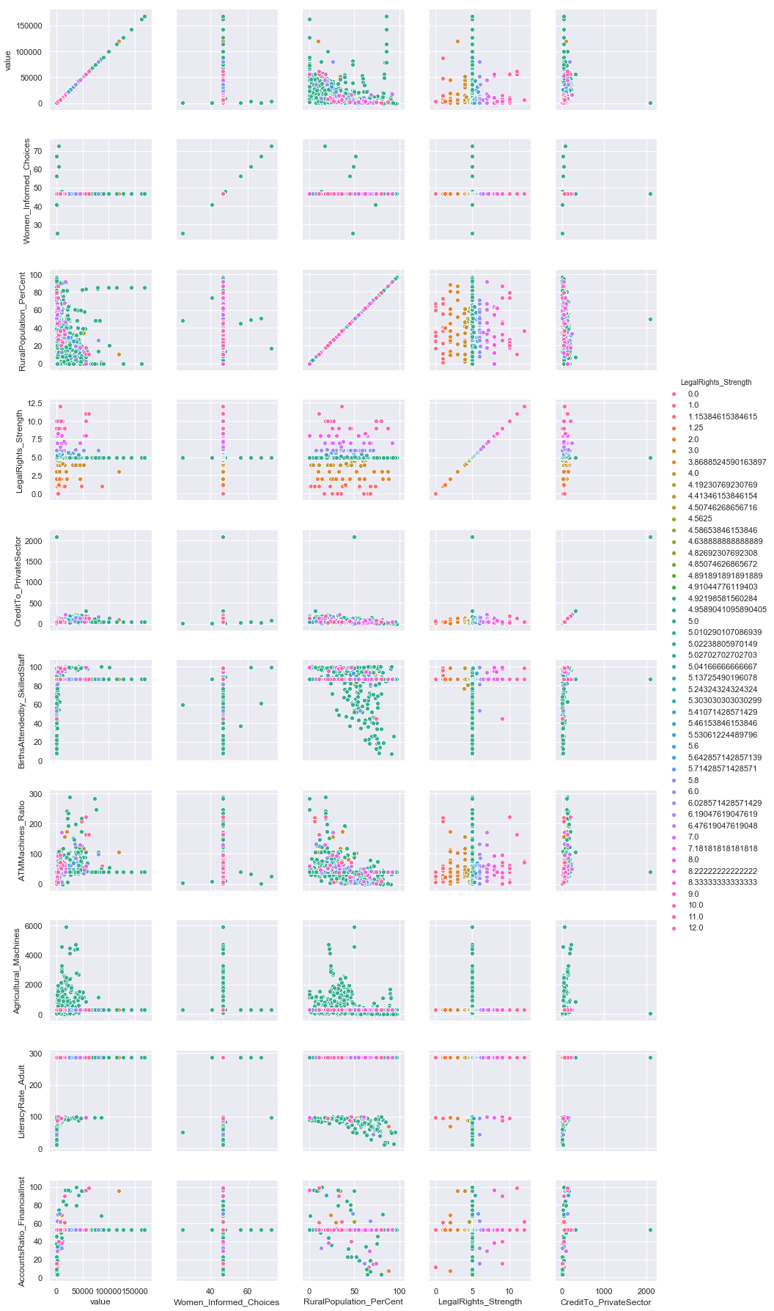
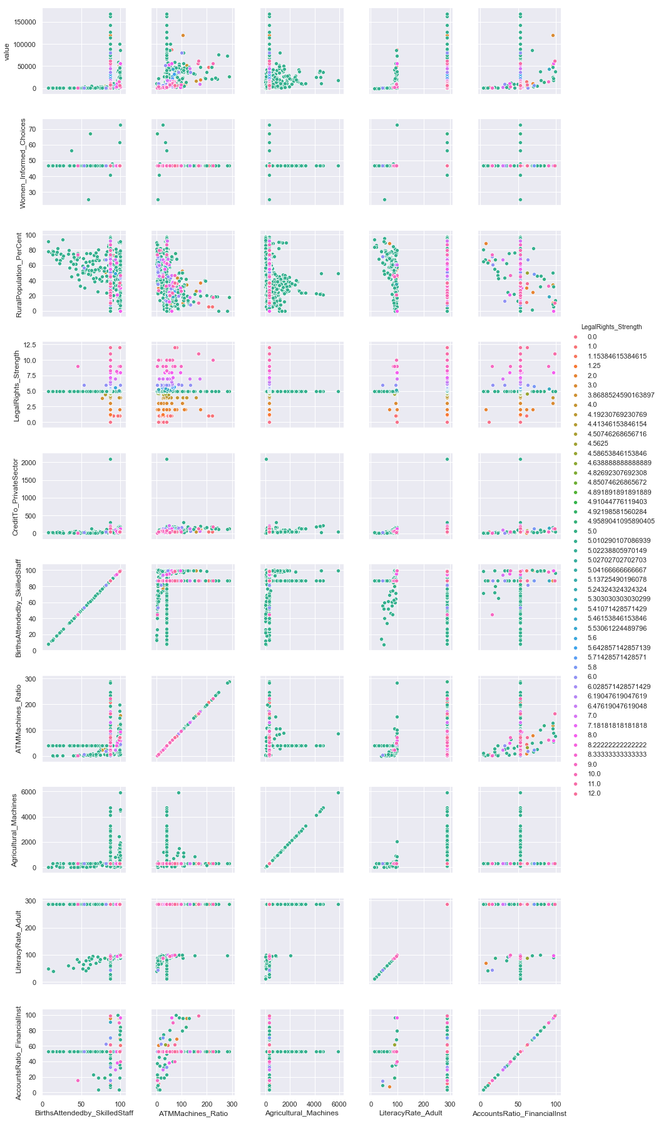
Pairplot Correlation of the Features
Contd.

Slide 10
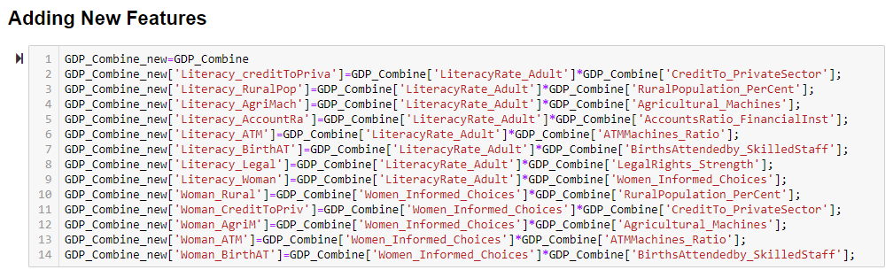
Feature Combining
We have combined few features to check the correlation.

Slide 11
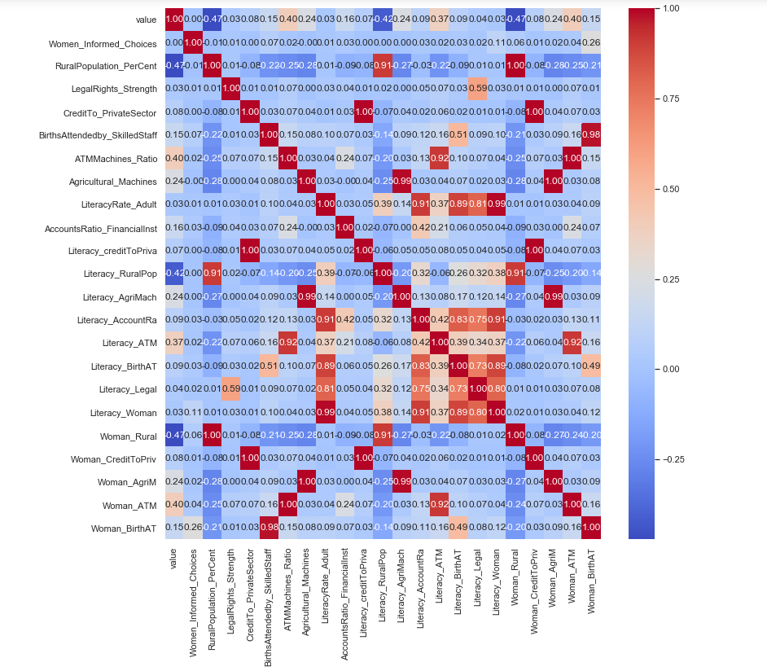
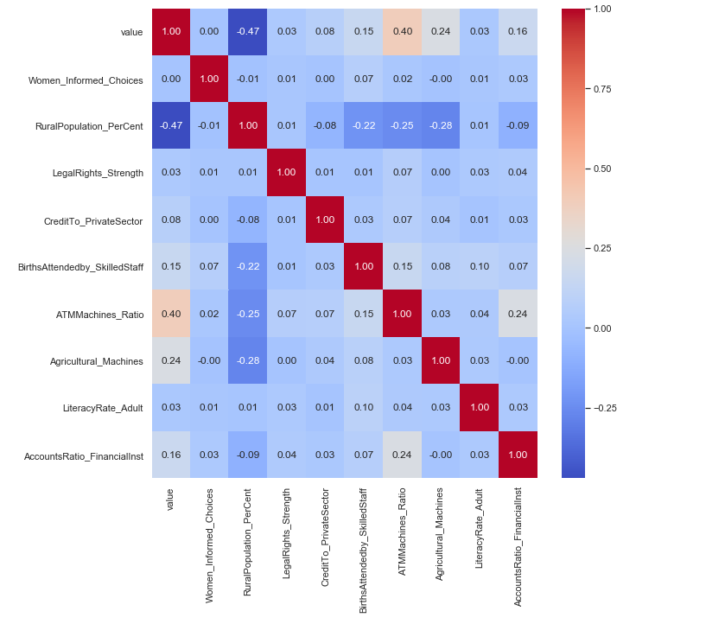
Features Correlation Matrix & Combining Features
Fig-2
Fig-1
Fig-1 represents the actual correlation of the features.
Fig-2 represents the correlation matrix with some new features added.
There is no significant change between correlation of features with value (GDP_value)
Contd.

Slide 12
Data Modelling & Validation Methods
Used various models to evaluate the performances:
Multiple Linear Regression
Polynomial Regression
degree = 3
Decision Tree Regression
max_depth of the tree = 30
Random Forest Regression
max_features used = 10, n_estimators used = 30
Ridge Regression
alpha = 0.0000001, normalize = True
Lasso Regression
alpha = 0.0000001, normalize = True
Elastic Net Regression
alpha = 0.001
PCA
Explained_variances = 95%
Ordinary Least Square Method (OLS)

Slide 13
Model Validation Methods
Root Mean Squared Error:
Measures the difference between values (sample or population values) predicted by a model and the values observed.
Test & Train Split:
The data is divided into test & train with parameters:
Test_size = 0.20
Random_state = 40
Cross validation:
k-Fold cross validation method:
Number of splits of data = 10
Random state = None
Shuffle = True
R - Squared:
Statistical measure that represents the proportion of the variance for a dependent variable that’s explained by an independent variable or variables in a regression model,
It is also known a coefficient of determination

Slide 14
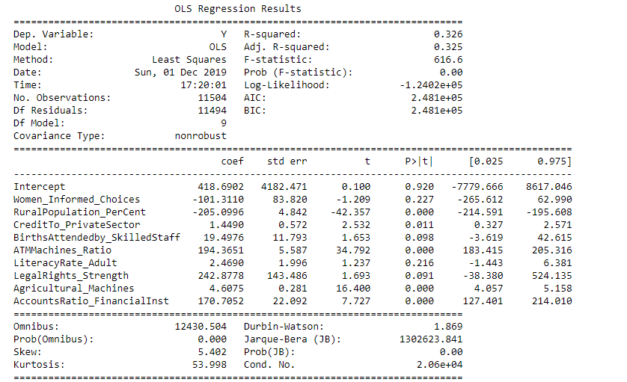
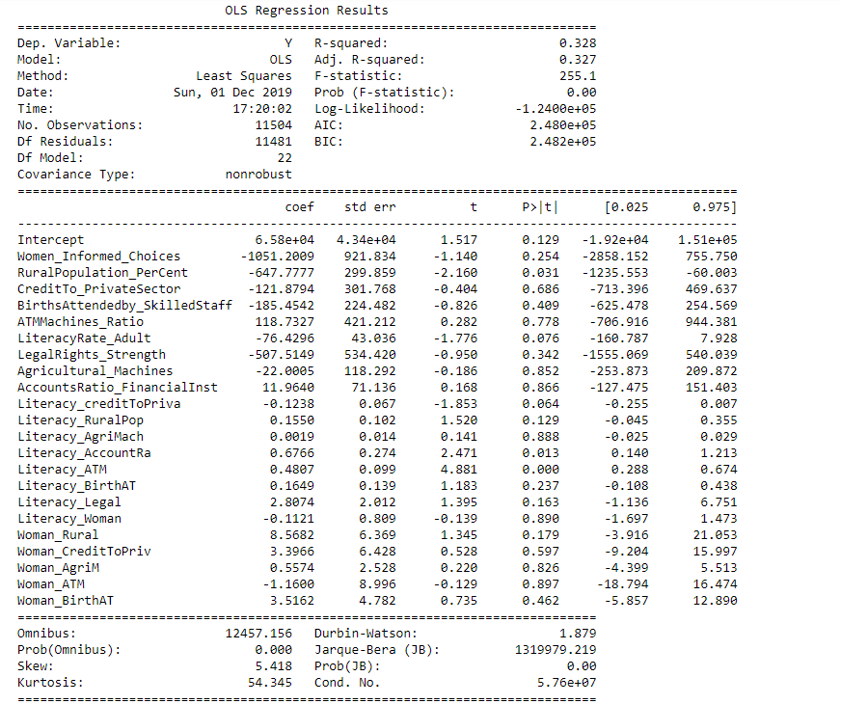
OLS Statistics
Without combined Features
With combined Features

Slide 15
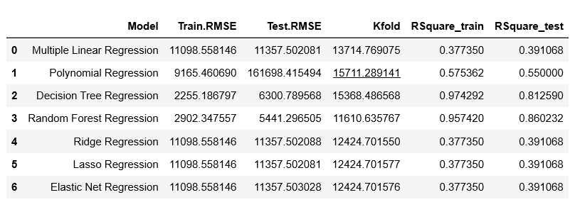
Model Evaluations
The least RMSE is for Decision Tree Regression and Random Forest Regression model and R-squared value is also the highest for these models.

Slide 16
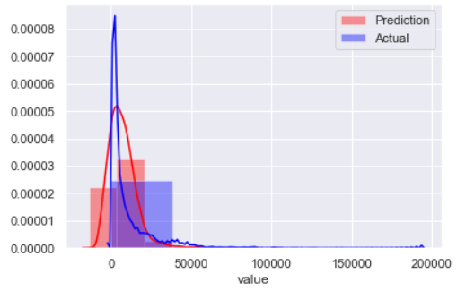
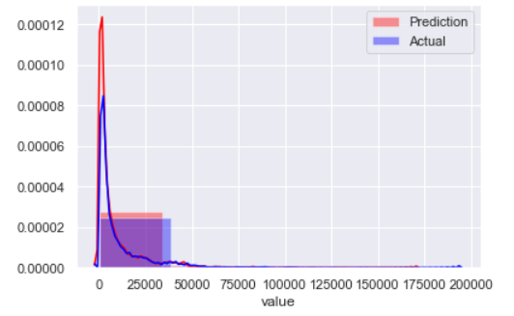
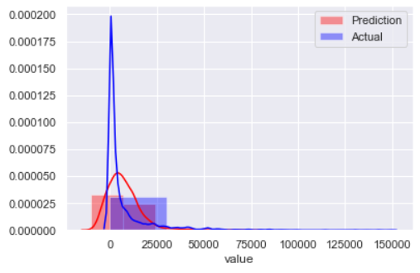
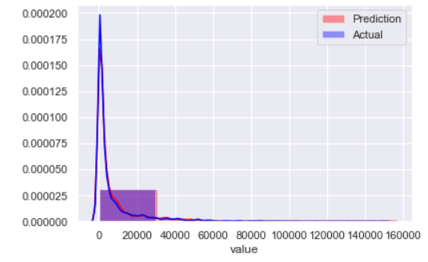
Multiple Linear Regression
Random Forest Regression
Train
Test

Slide 17
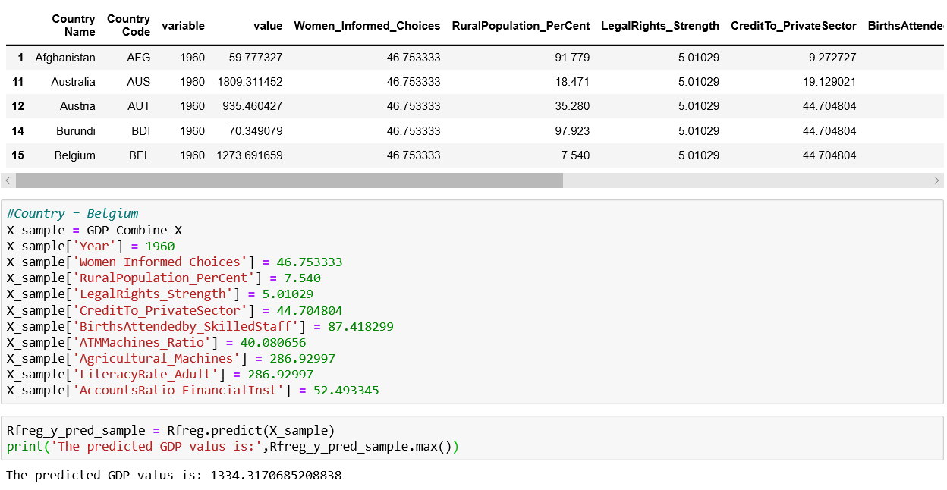

Slide 18
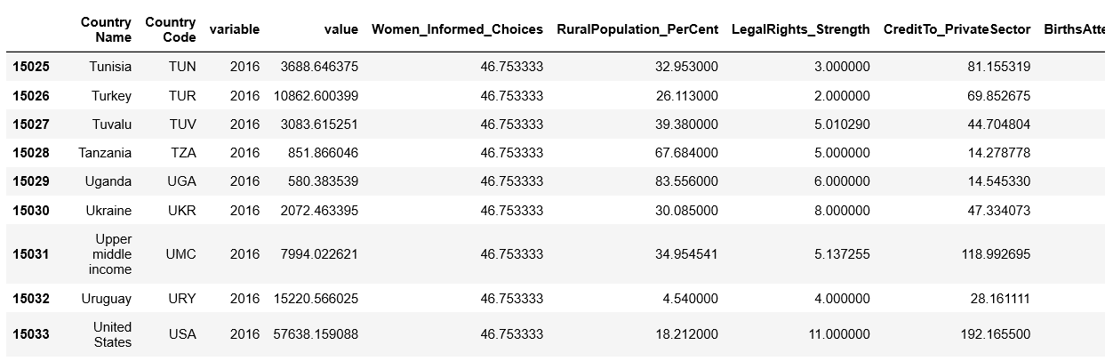
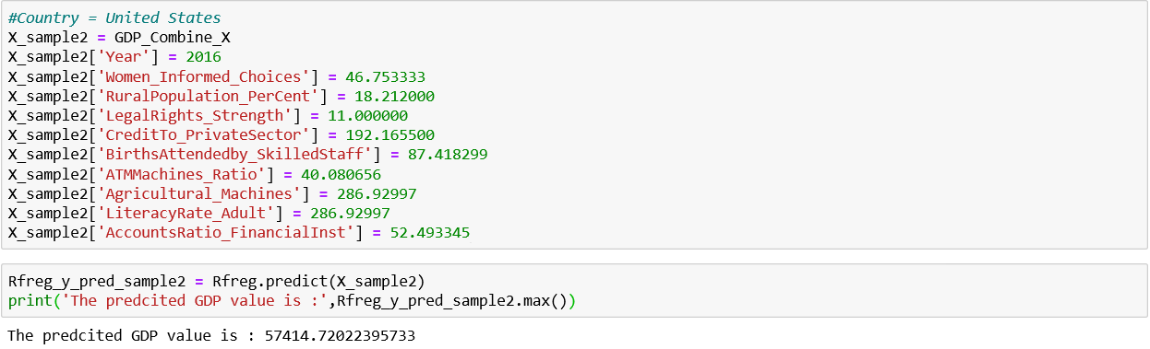

Slide 19
Conclusions
We performed all the essential Data Science steps required to make an efficient and high performing model.
We explored all the Supervised Learning models and compared the performance to get the best fitted model.
We also found out efficient and faster ways like OLS to decide features to be added to the model to improve it’s accuracy.
We evaluated our model using various validation techniques and tested the accuracy of our model by picking random samples from the data set and predicting it’s GDP values.

Slide 20
References
Roberto Golinelli and Giuseppe Parigi. Tracking world trade and GDP in real time. Temi di discussione (Economic working papers) 920, Bank of Italy, Economic Research and International Relations Area, July 2013.
A. George Assaf, Gang Li, Haiyan Song, and Mike G. Tsionas. Modeling and forecasting regional tourism demand using the bayesian global vector autoregressive (bgvar) model. Journal of Travel Research, 58(3):383–397, 2019.
Marek (Tax Automation at Dell). kaggle datasets. https://www.kaggle. com/stieranka/predicting-gdp-world-countries. last accessed-November 6,2019.
Vladislav Marjanovi´c, Miloˇs Milovanˇcevi´c, and Igor Mladenovic. Prediction of gdp growth rate based on carbon dioxide (co2) emissions. Journal of CO2 Utilization, 16:212–217, 12 2016.
The world bank data. https://data.worldbank.org/. last accessed-October 31st, 2019.
kaggle datasets. https://www.kaggle.com/datasets. last accessed-October 31st, 2019.

Slide 21


